Slide 1
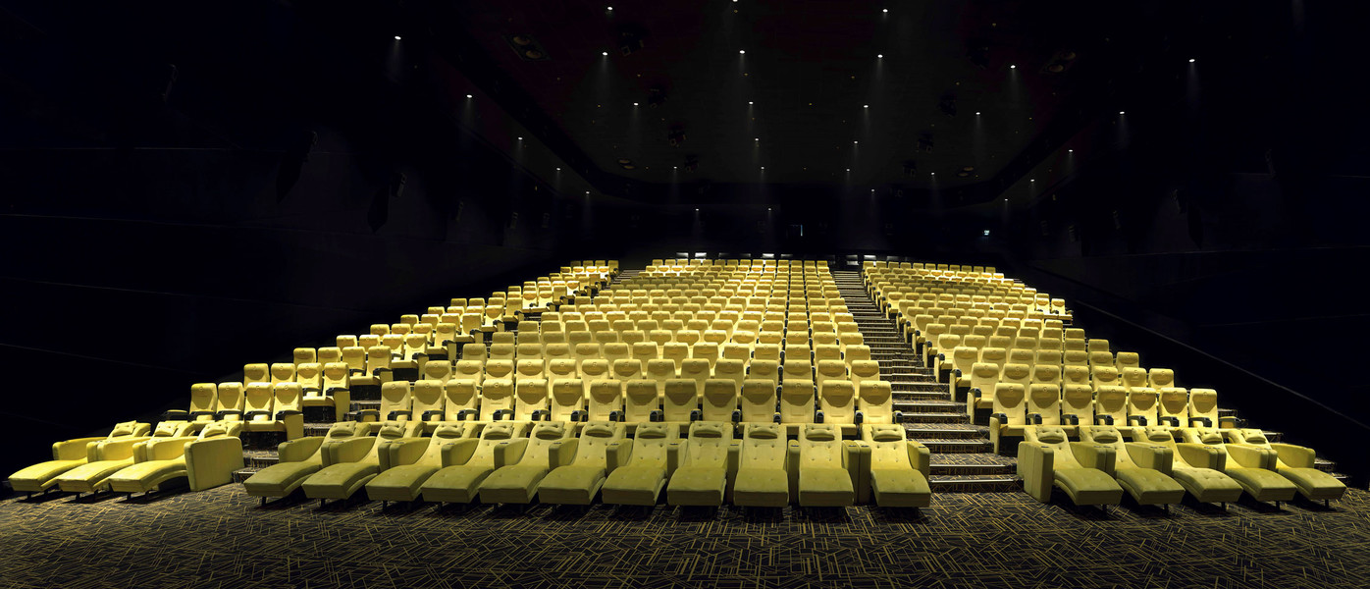
movie ticket booking system
MOVIE TICKET BOOKING SYSTEM

Slide 2
Team Members Group -07 Project Lead : Rajeshwar Sharad Jagtap
Back End Members
Patil Nisha
Pragathi S S
Puvvala Mrunalini Sai Padmini
Rachana V K
Rohit Shantaram Badgujar
Front End Members
Pothana Uday
Pratyushni Panda
Rahul Kesharwani
S Nadeem Shakeeb

Slide 3
Index
Introduction
Project Scope
Tools and Technologies
Hardware Requirement
Data Flow Diagrams
Use Case Diagram
ER Diagram
Class diagram
Tasks Performed
Output Screen shots
Conclusion

Slide 4
Introduction
Online Movie Ticket System is a digital platform that allows customers to access the service of a business,reserve seats and buy tickets.
Customers may view the contents of any movie show at any time and may book any movie ticket as needed
Manage the details of movie,ticket,customer and show timing
The project is totally built at administrative end and thus only the administrator is guaranteed the access

Slide 5
Project Scope
This project “Online Movie Ticket Booking System ” makes the task faster and easy. This is used to manage records.
The scope of project is to enable the User to select theatre and then book the desired seat numbers in available seats.
Motive of this is to booking tickets online.
The user can first Register using Personal details and User can login in.
User can update is personal details as per requirement

Slide 6

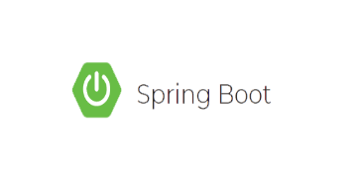



Tools and Technologies
Front end : Angular
HTML, CSS, JavaScript
SERVER SIDE:
Spring Boot
BACK END:
MYSQL , Hibernate
SERVER:
Tomcat

Slide 7
Requirements
REQUIRED HARDWARE:
RAM : 4 GB
Hard Disk : 1 TB
Processor : Intel i3 /i5
REQUIRED SOFTWARE:
Operating System : Microsoft Windows 7/8/10
Database : Microsoft SQL Server 2012
Tools : Microsoft Visual Studios 2012
Language Requirement : java
Web server : Tomcat Server

Slide 8
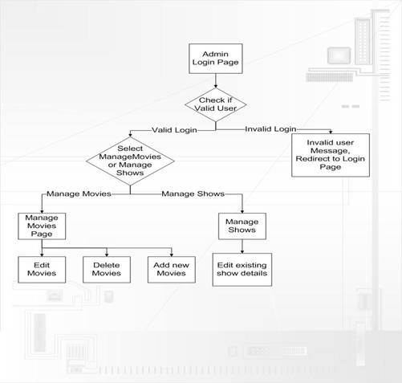
Data Flow Diagram - Admin

Slide 9
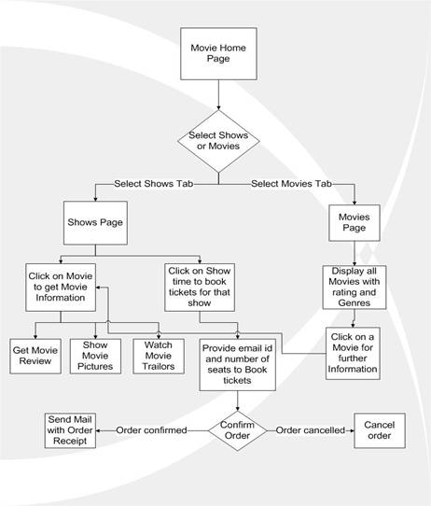
Data Flow Diagram-User

Slide 10
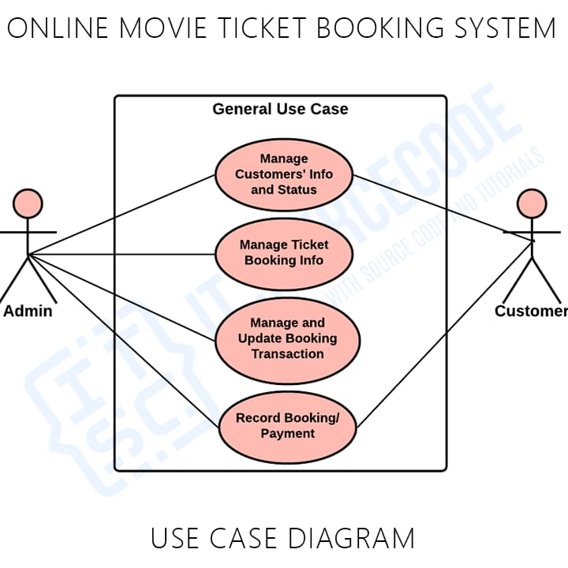
USE CASE Diagram

Slide 11
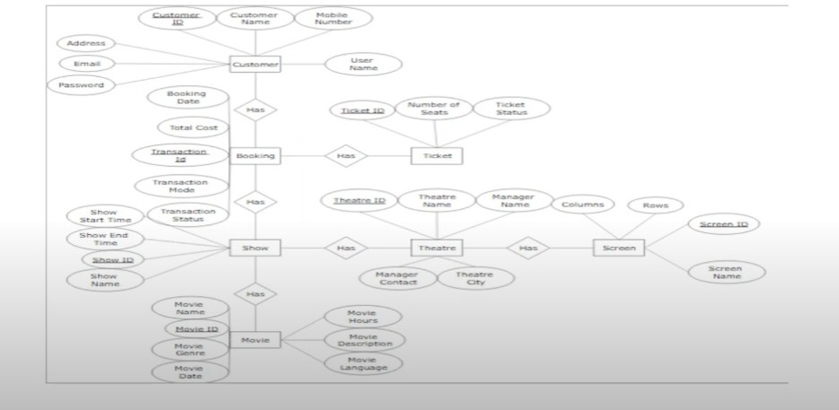
ER Diagram

Slide 12
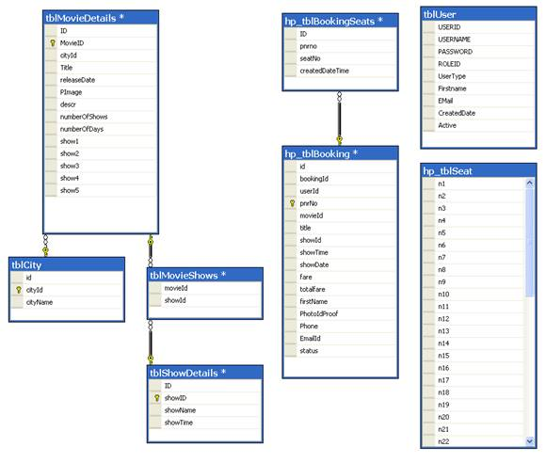
Class diagram

Slide 13


Task Performed
The system is a web-based application, developed using spring framework as a backend and angular as a front-end that performs the following functions:
Enables the Administrator to create and manages the lifecycle of different types of users
ADMIN
USER

Slide 14
Tasks Performed by Admin
Manage customer
Manage movie
Manage booking
Manage ticket

Slide 15
Tasks Performed by User
Customer can see list of movies
Customer can see ratings and description of movies
Customer can select movie
Customer can select theatre and show as per their requirement
Customer can book tickets through online mode

Slide 16
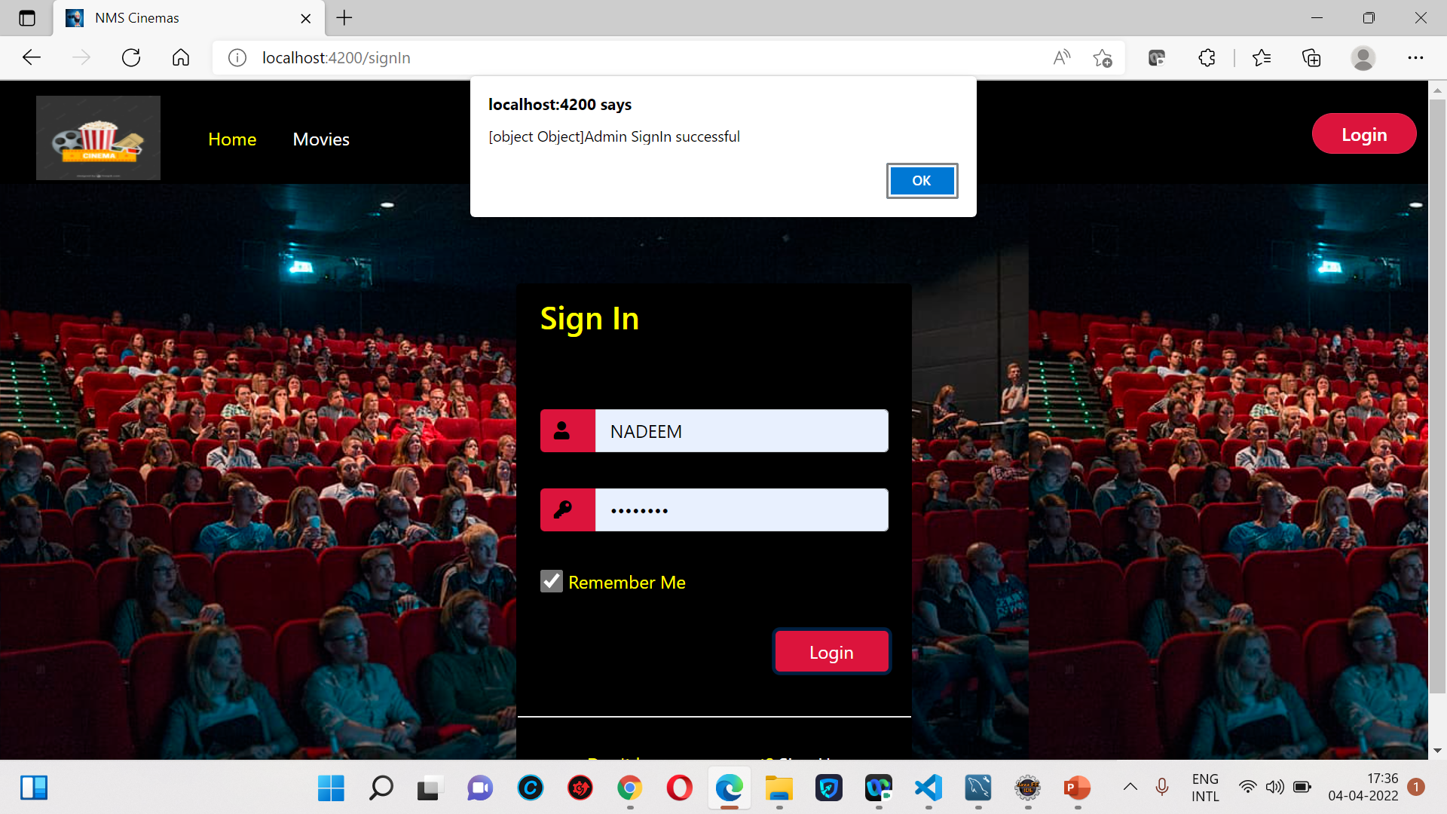
Output Screen shots: Admin log in page

Slide 17
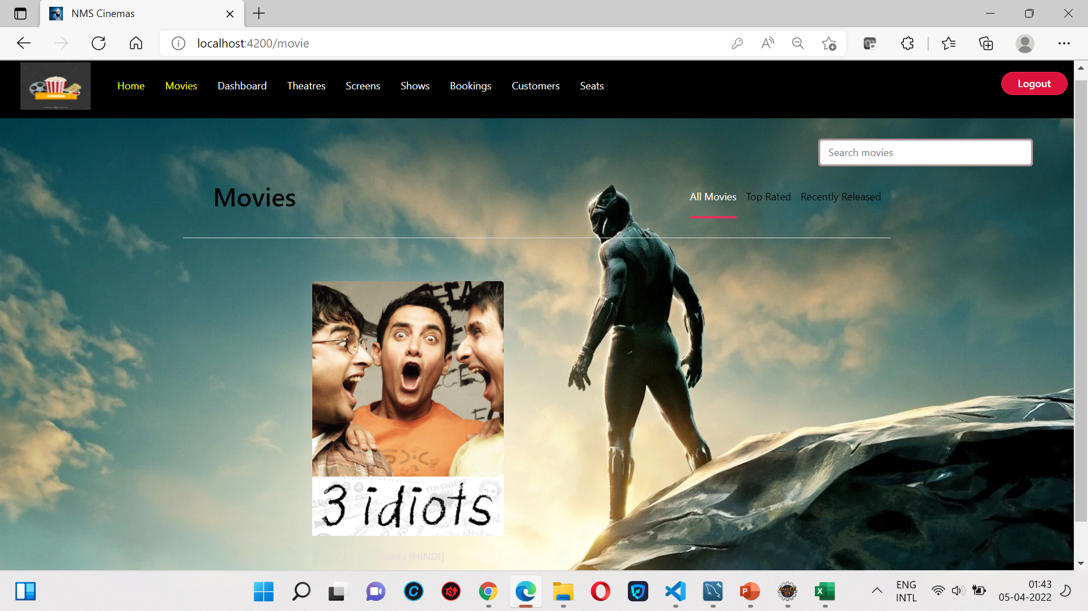
Admin home page

Slide 18
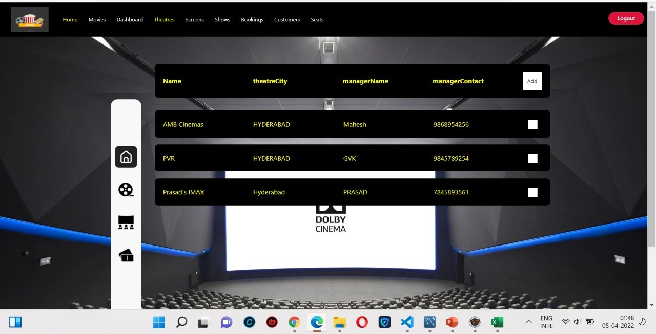
Theatre management page

Slide 19
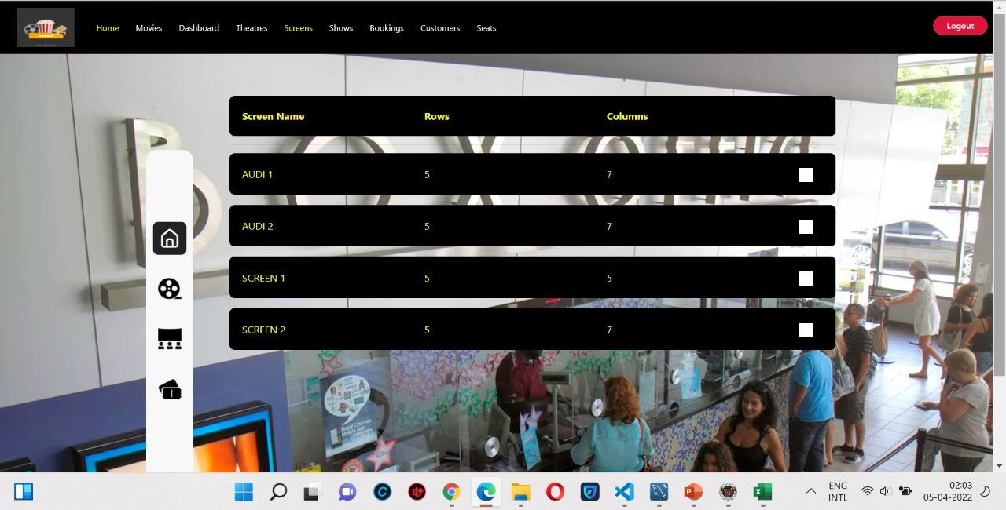
Screens adding page

Slide 20
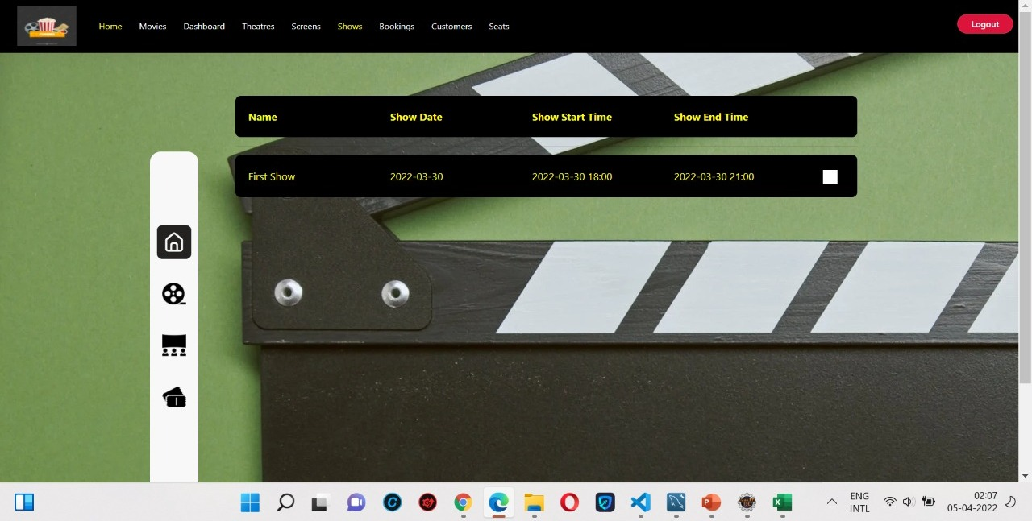
Shows adding page

Slide 21
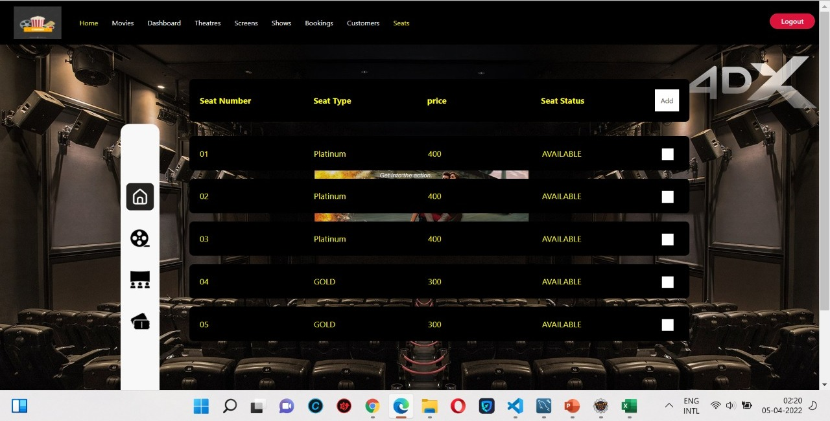
Seats adding

Slide 22
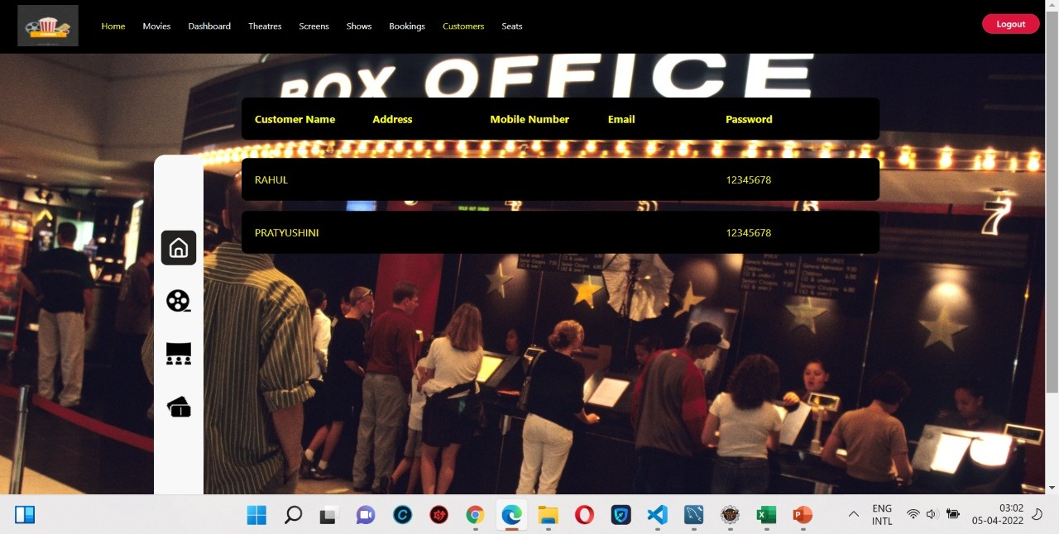
Customer details

Slide 23
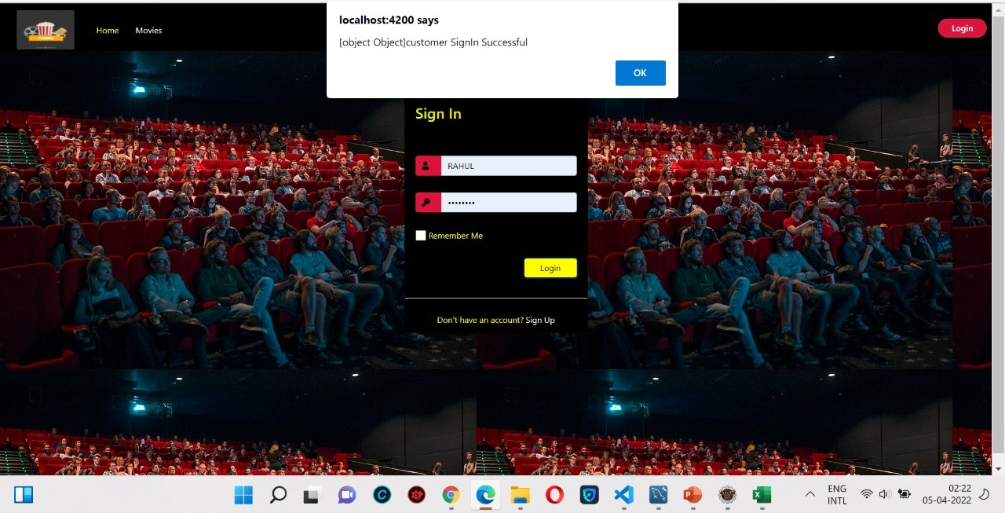
Customer log in page

Slide 24
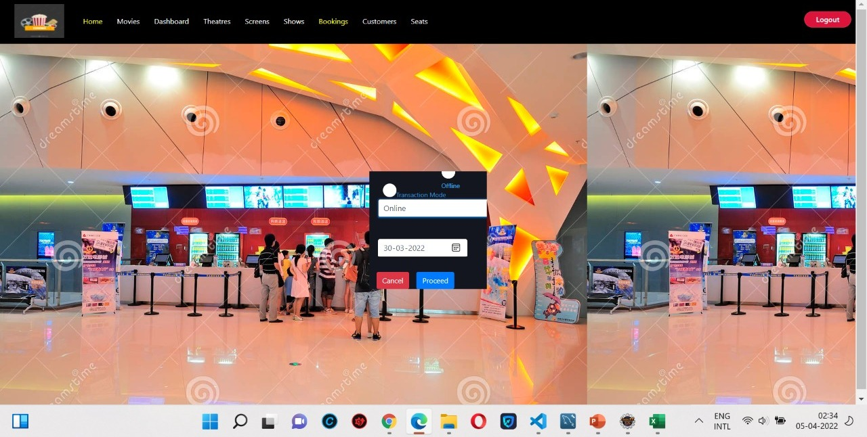
Booking page

Slide 25
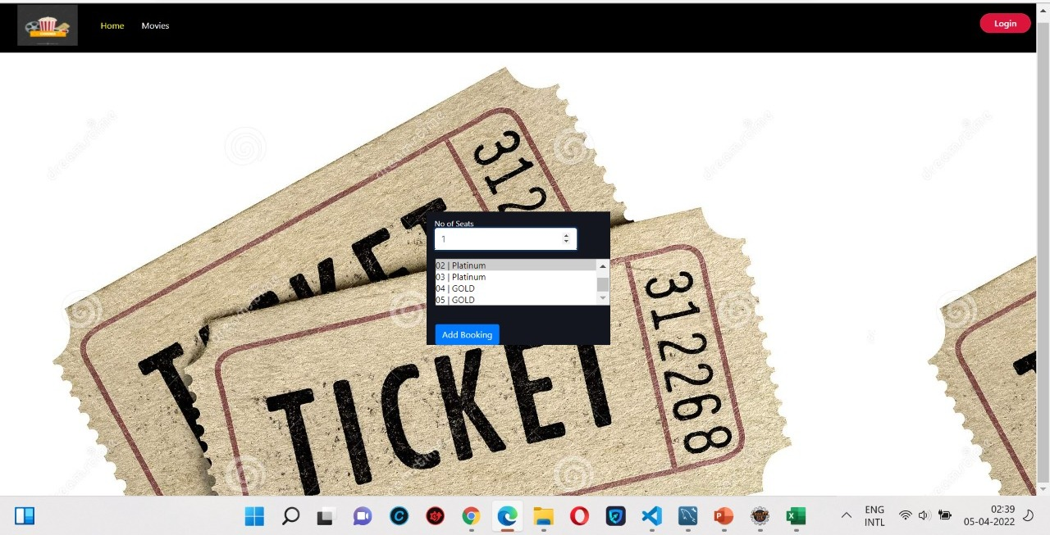

Choosing seats

Slide 26
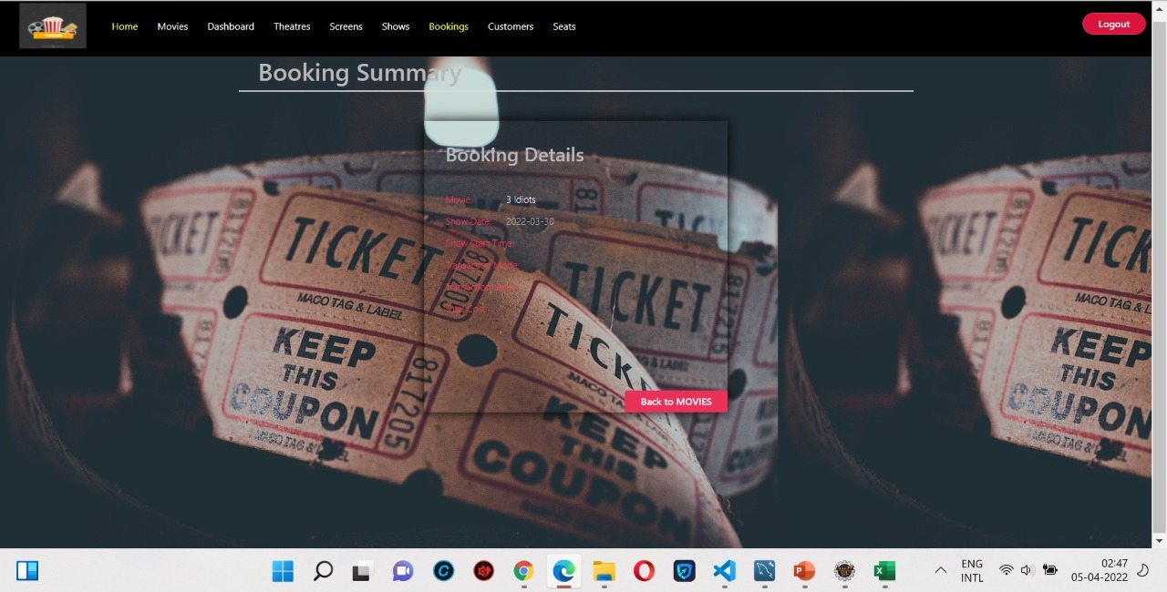
Booking summary

Slide 27
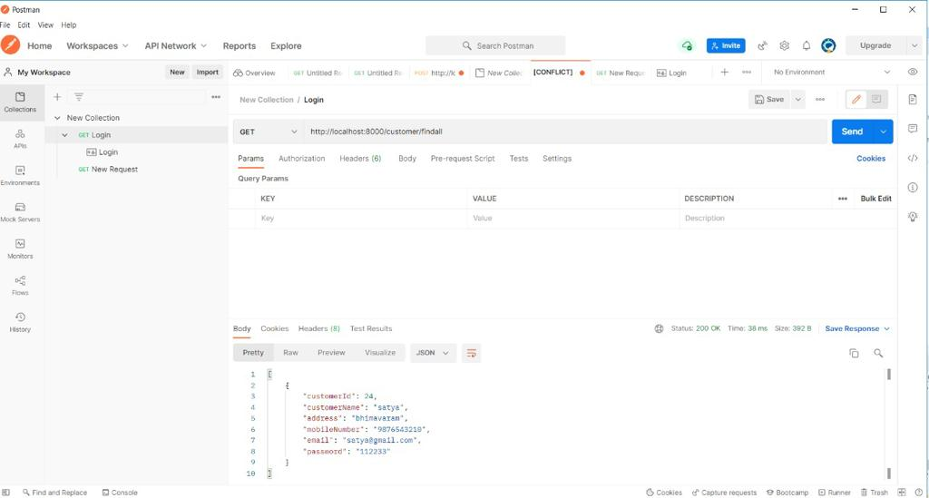

Slide 28
Conclusion
The project has been developed successfully and the performance of the system has been found satisfactory.
Customer can get the immediate information about running movies and reserve their seat without wasting their precious time.
User friendly interface also for a admin to add and delete movie information

Slide 29
THANK YOU…

